Slide 1

AMITY UNIVERSITY BENGALURU
SOURCE CODE MANAGEMENT
LAB MANUAL
SUBMITTED BY: SUBMITTED TO:
Likitha k v Dr. MONITH KAPOOR
A86605224074
B.TECH IN CSE

Slide 2
SI. NO | INDEX
1. | Basics of Linux
2. | Introduction-Git Bash
3. | Git Bash And Git Hub
4. | File Creation with commit and push command
5. | Branches Creation
6. | Merge Request
7. | Open and Close Pull Request
8. | Complete Git Process

Slide 3
EXPERIMENT-01:
• Basics Of Linux:
1.What is Linux ?
Linux is a family of free and open-source operating systems based on the Linux kernel. Operating systems based on Linux are known as Linux distributions or distros. Examples include Debian, Ubuntu, Fedora, CentOS, Gentoo, Arch Linux, and many others.
Linux Distributions (Distros)
Different versions of Linux tailored for various needs:
Ubuntu – User-friendly, great for beginners.
Debian – Stable and well-tested.
Fedora – Latest features, cutting-edge.
Arch Linux – Lightweight and customizable.
CentOS / RHEL – Used in enterprise environments.
3.Linux File System Structure
Linux follows a hierarchical structure:
bin → essential binary programs
etc → configuration files
home → user directories
root → root user’s home directory
var → variable data (logs, etc.)
tmp → temporary files
usr → user-installed software

Slide 4
Basic Linux Commands
4.Command Description
ls | List files in a directory
cd | Change directory
Pwd | Print working directory
mkdir | Make a new directory
rm | Remove files/directories
cp | Copy files/directories
mv | Move or rename files
cat | Display file content
sudo | Execute a command as superuser
man | Show manual/help for a command
5.File Permissions
Linux controls file access with permissions.
Use ls -l to view them (e.g., -rwxr-xr--).
Modify with chmod, chown, or chgrp.

Slide 5
6.Package Management Install/update software using package managers: Debian/Ubuntu: apt (e.g., sudo apt install package-name) Red Hat/Fedora: dnf or yum o Arch Linux: pacman 7.Shell and Terminal 1.The shell interprets commands (e.g., bash, zsh). 2. Terminal is where you type the commands. 8.Users and Permissions 1. Regular users vs. root (superuser). 2. Manage users with adduser, usermod, and passwd. Experiment-02: Introduction -Git Bash 🚀 What Is Git Bash? Git Bash is a command-line tool for Windows that provides: - Git command-line tools - A Bash (Unix-style) shell - A way to run shell commands similar to those used in Linux/macOS It's especially useful for developers using Git on Windows who want a Unix-like experience.

Slide 6
✅ Key Features:
1. Bash Emulation:
Bash (Bourne Again SHell) lets you run Linuxstyle commands (e.g., ls, pwd, rm).
This makes it easier to follow tutorials written for Linux/macOS.
2. Git Integration:
o You can run Git commands like git clone, git status, git commit directly in Git Bash. o Useful for version control and managing code repositories.
3. Cross-Platform Compatibility:
o Lets Windows users interact with remote Linux servers or repositories more easily.
🖥️ How to Install Git Bash:
Go to https://git-scm.com
Download the installer for your OS (choose Windows).
Run the installer and select “Git Bash” when prompted about default terminal.
After installation, right-click anywhere and choose “Git Bash Here” to open the terminal.

Slide 9
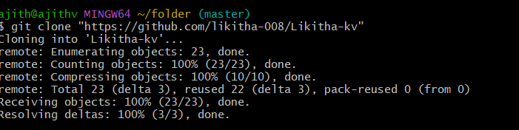
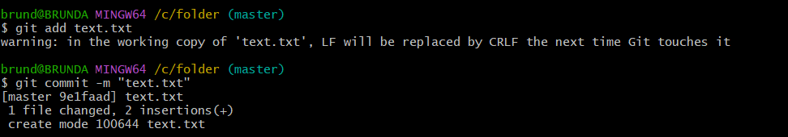
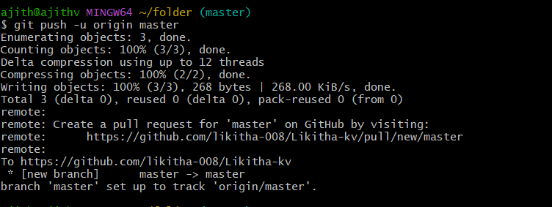
2.Make changes to our project files.
3.Stage and commit changes:
.Push changes to GitHub:
4.Push changes to GitHub:

Slide 10
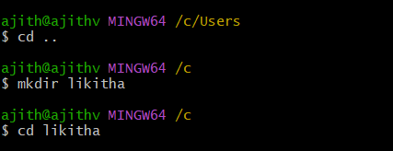

Experiment-04: jfngkjdfgjdfjgdfgdb
• File Creation With Commit And Push Command.
Ø To Create a file,commit it and push it to a remote repository using Git Bash
1.Create a File.
Open Git Bash and create a folder :
Using cd and mkdir create a folder:
Then git init command to create a new Git repository
Create a new file using vi command in Linux is used to open and edit files using the vi editor, a powerful text editor available on most Unix-based systems:

Slide 11

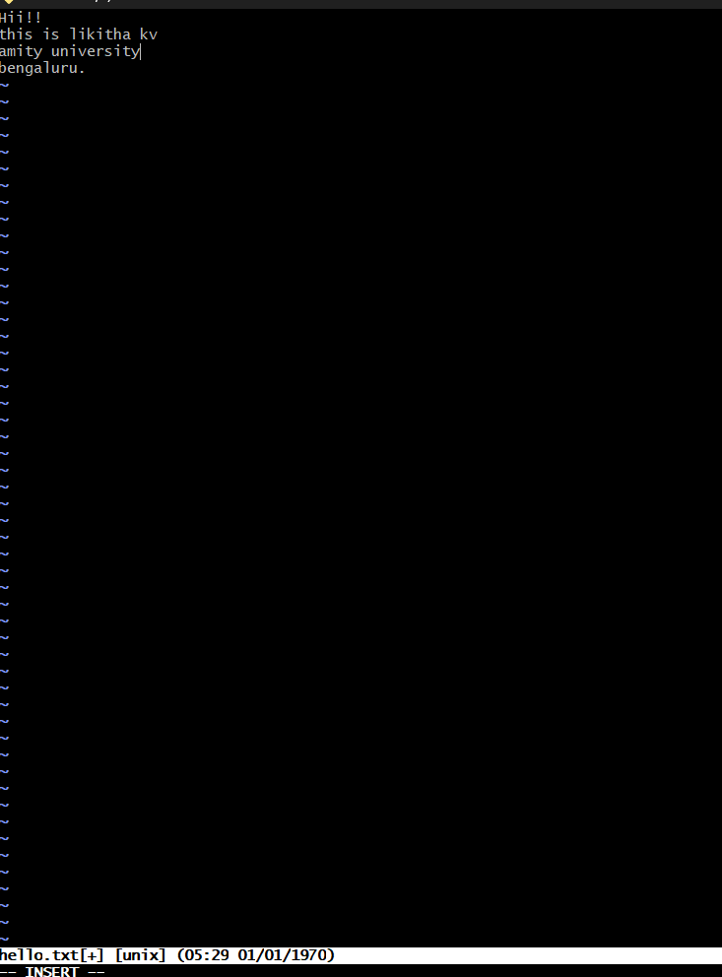
Now open the file and write:

Slide 12

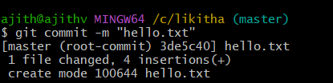


To add all files in the directory
3.Commit the File: o Commit the changes with a message.
4.Add and push to remote repository:
Push the changes to Git Hub (assuming origin is the remote and main is the branch.)

Slide 13
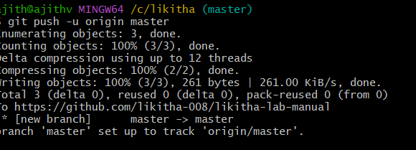


To create new branch ;

Slide 14

Switching to a Branch:
To switch to the newly created branch:
Experiment-06:
• Merge Request
o A Merge Request(MR) is a feature used in Gitbased platforms like GitLab to propose and review changes before merging them into the main branch.It is similar to a Pull Request(PR) in GitHub.
How Merge Request Works:
1. Create a Branch
A developer creates a separate branch from the main branch (often called main or master) to work on a specific feature, bug fix, or enhancement.
2. Make Changes
The developer writes code, commits changes to their branch, and pushes the branch to the remote repository.

Slide 15
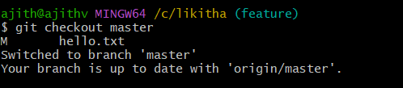
3.Open a Merge Request
In the Git platform (e.g., GitLab, GitHub):
The developer opens a merge request from their feature branch into the target branch (usually main).
They add a description, possibly link related issues, and assign reviewers.
4. Code Review
Reviewers (team members or maintainers) review the code.
Automated checks (e.g., tests, linters) are run via CI/CD pipelines.
Feedback might be given; the author can make additional commits to address it.
Merge
The MR is merged into the target branch:
Options include merge, squash and merge, or rebase and merge.
Once merged, the feature branch can be deleted if no longer needed.
Steps to Merge the Branch:
1.Switch to the main branch (master):

Slide 16
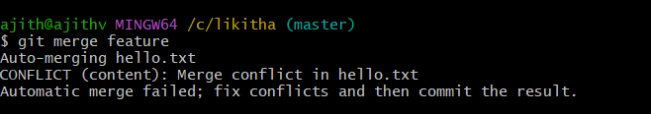
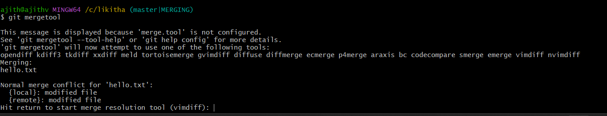
Merge the branch:
Using git mergetool and git merge main command:
Now Press enter to edit the files and windows are opening ,then remove some red lines and add some lines:

Slide 17
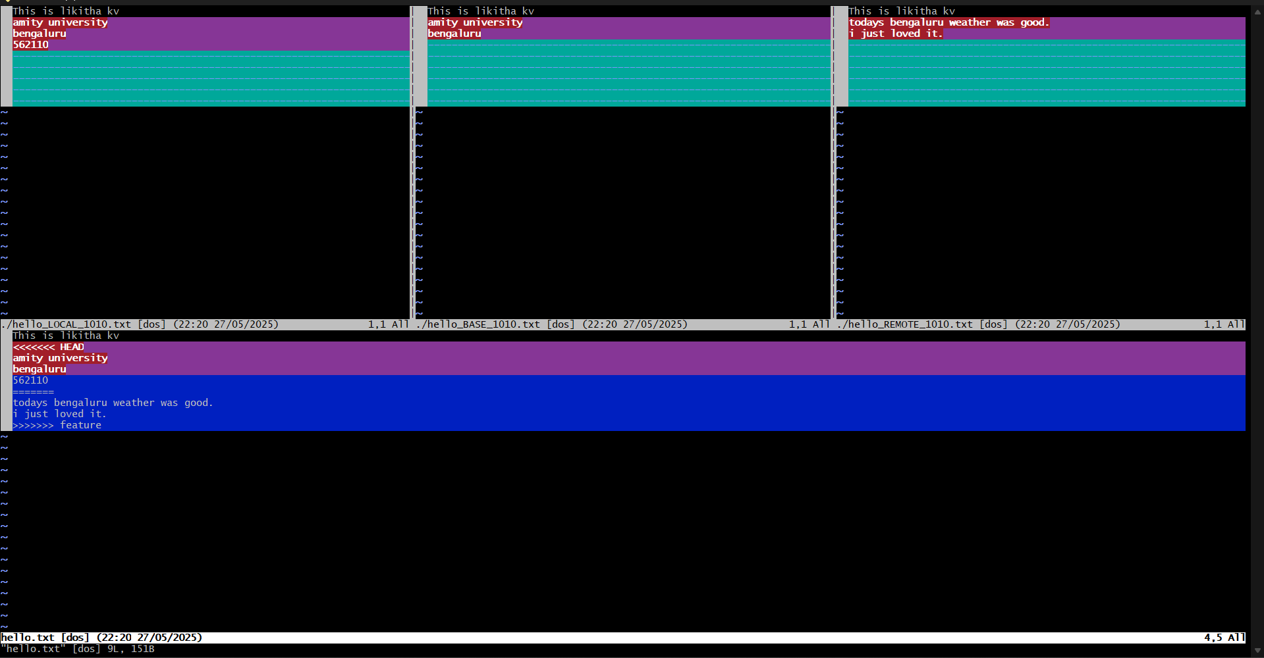

Slide 18

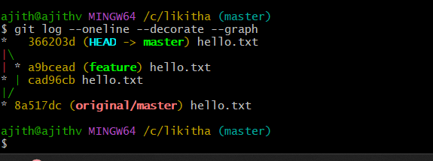
To remove merging commit one line:
Using the command graph we can see the graph of commits:

Slide 19
Benefits:
Facilitates code review
Triggers automated tests
Maintains a clear change history
Encourages collaborative development Experiment-07:
Open and Close Pull Request
1. Open a Pull Request
Push your changes to a branch on your fork or the same repository.
Go to GitHub, navigate to the repository.
You’ll see a “Compare & pull request” button — click it.
Add a title and description for your PR.
Click “Create pull request”.
2. Close a Pull Request
Click “Merge pull request”.
Confirm by clicking “Confirm merge”.
Optionally, delete the branch.
In the git hub account select the user which whom you want to merge and select the repo and fork it:

Slide 20
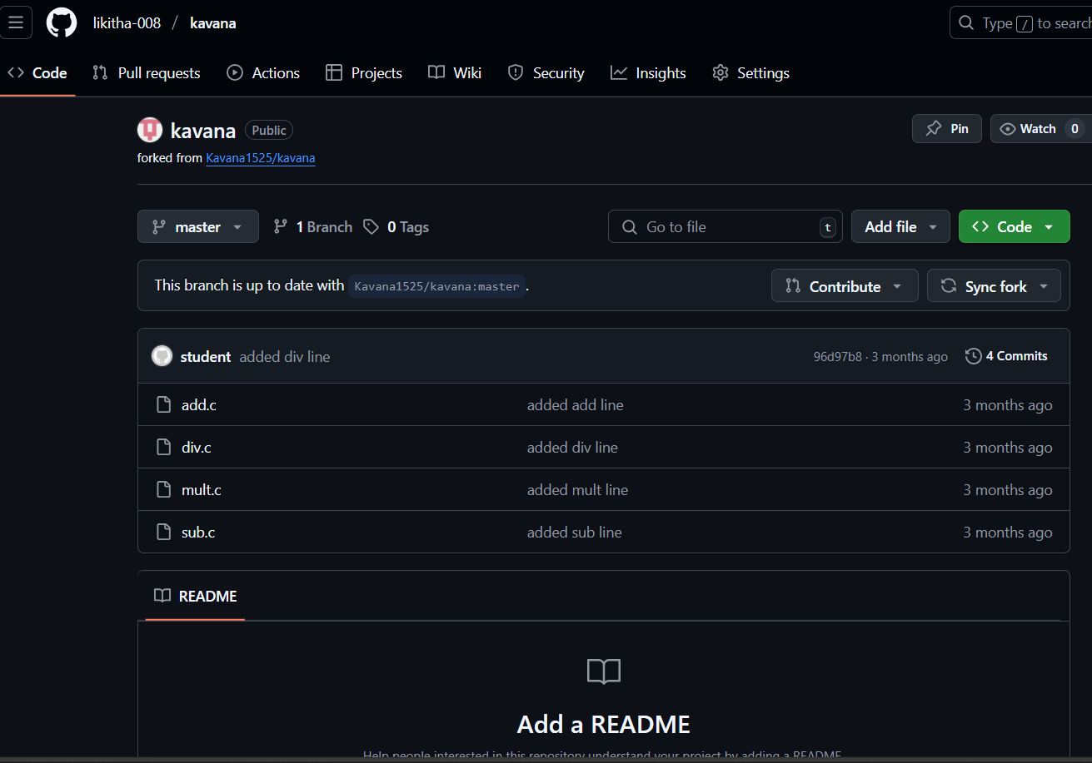

Slide 21
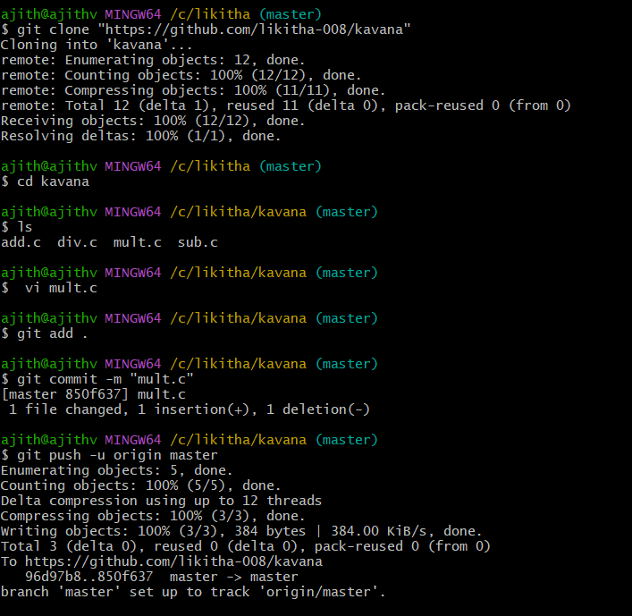
Now copy the link and using git clone command open that file:

Slide 22
In the Git Hub account contribute to open the pull request:
Steps to Close a Pull Request on GitHub:
1. Go to the repository on GitHub. 2. Click on the "Pull requests" tab.
Find the pull request you want to close and click on it.
Scroll to the bottom of the PR page.
Click the “Close pull request” button.

Slide 23
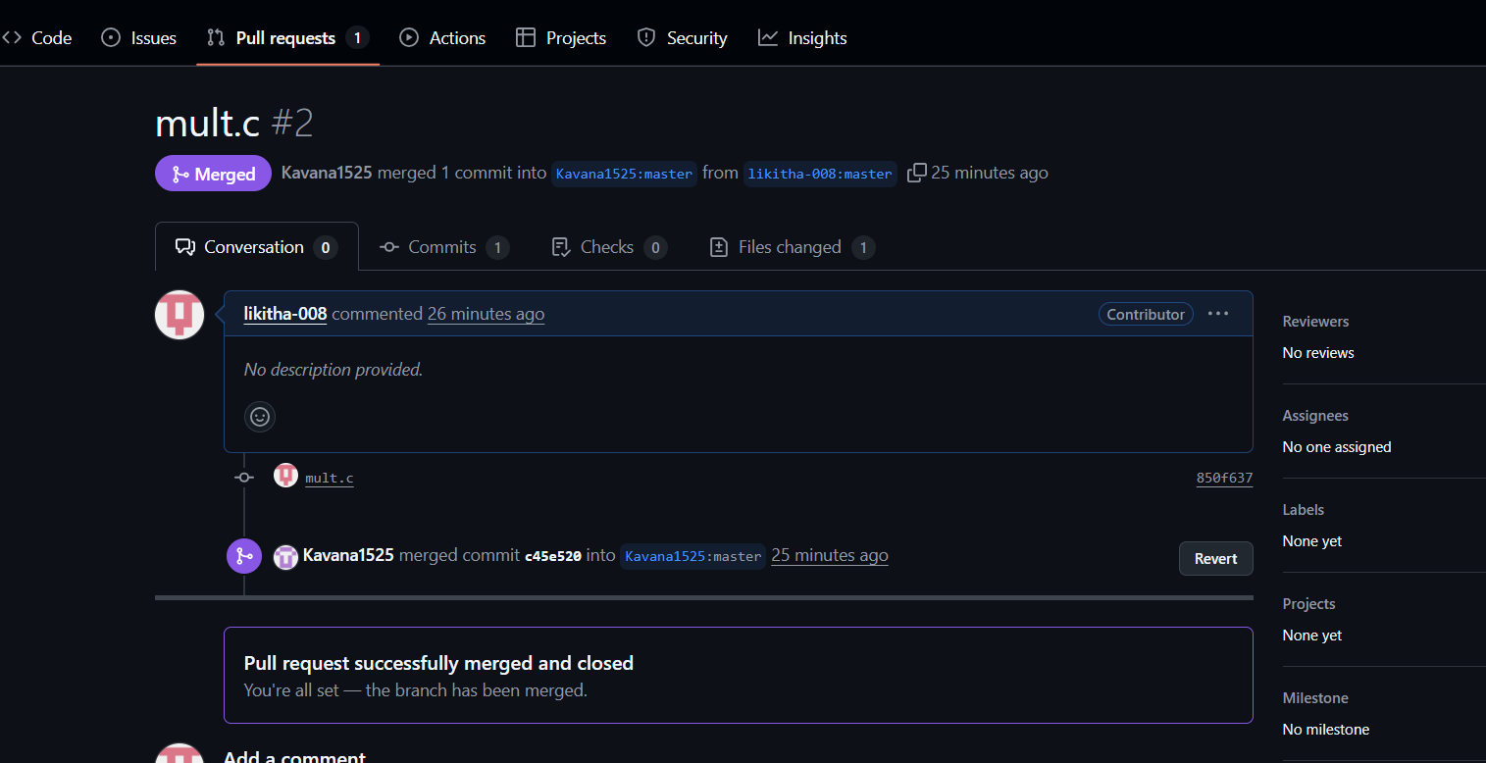

Slide 24
Experiment-08:
• Complete Git Process.
1. Install Git Bash
Download Git for Windows from Git's official website.
Run the installer and follow the setup instructions.
Choose Git Bash as the default terminal option.
2.Initialize a Repository
Open Git Bash and navigation to our project folder.
Initialize a new git repository
3.Create and Modify Files
Create a file using vi command:

Slide 25

4.Check Repository Status
View changes
5.Stage and Commit Changes
Add files to the staging area
Commit changes:

Slide 26
Create and Manage Branches
• Create a new branch:
Switch to the branch:

Slide 27
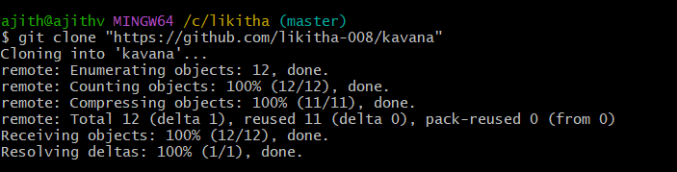
Merge the branch into the mainbranch:
Git Clone:

Slide 28
Pull Changes from Remote Repository
• Update local repository:
8. Pull Changes from Remote Repository
Open and Close Pull Requests
Open a Pull Request on GitHub and merge changes.
Close the Pull Request if needed

Slide 29
